Slide 1
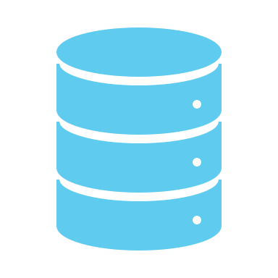
Oracle Data Integrator
Components and Types of Transformations

Slide 2
What is ODI ?
Oracle Data Integrator (ODI) is a statistics integration platform that consists of all the combination needs. It gives a brand-new declarative layout technique this is used to outline the statistics transformation and integration system. Thus, ensuing in clean renovation and development.
ODI gives a high-overall performance degree to execute the statistics validation and transformation system primarily based totally on an Extract, Load, and Transform (ELT) architecture. It additionally presents the maximum cost-powerful solution.
ODI can provide a unified infrastructure to streamline statistics and alertness integration projects. It presents a graphical surroundings to build, manage, and preserve the statistics integration system.

Slide 3
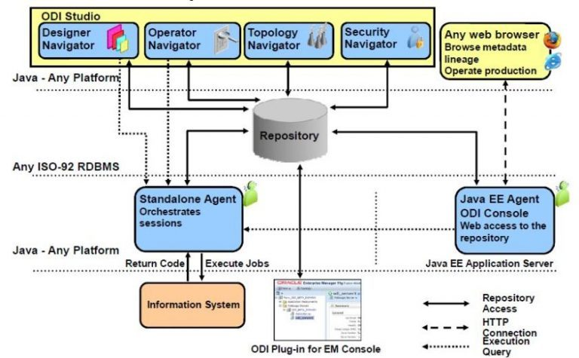
ODI Architecture

Slide 4
Some key features of Oracle Data Integrator include:
Graphical Interface: ODI provides a user-friendly graphical interface for designing data integration workflows. This interface allows developers to visually create and configure data flows, transformations, and mappings.
ELT Architecture: ODI follows an ELT (Extract, Load, Transform) approach, where data transformation operations are performed directly within the target database rather than in a separate ETL server. This approach leverages the processing power of the target database and can lead to better performance for large-scale data integration tasks.
Integration with Oracle Products: ODI is tightly integrated with other Oracle products and technologies, such as Oracle Database, Oracle Golden Gate, Oracle Business Intelligence, and Oracle Warehouse Builder. This integration allows seamless data integration and interoperability within the Oracle ecosystem.

Slide 5
Some key features of Oracle Data Integrator include:
Support for Heterogeneous Data Sources: ODI supports integration with a wide range of heterogeneous data sources, including relational databases, flat files, XML files, web services, and more. This enables users to integrate data from diverse sources into a unified data warehouse or data mart.
Parallel Processing: ODI can leverage parallel processing capabilities to improve the performance of data integration tasks. By distributing data processing across multiple nodes or threads, ODI can efficiently handle large volumes of data and reduce overall processing time.
Change Data Capture (CDC): ODI supports Change Data Capture (CDC) mechanisms, allowing users to capture and replicate only the changed data from source systems to target systems. This helps minimize data transfer and improves the efficiency of data integration processes

Slide 6
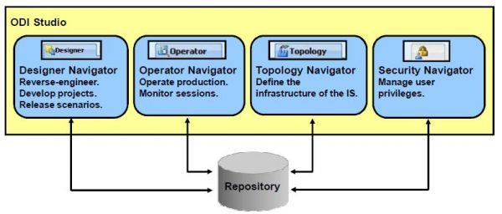
Components of ODI

Slide 7
Components:
Oracle Data Integrator (ODI) consists of several key components that work together to facilitate the design, execution, and management of data integration processes. These components include:
ODI Studio: ODI Studio is the graphical integrated development environment (IDE) used by developers and administrators to design, develop, and maintain data integration workflows. It provides a user-friendly interface for creating interfaces, mappings, packages, procedures, scenarios, and other artifacts necessary for data integration tasks.
Repository: The Repository is a centralized metadata repository that stores all the configuration, design, and runtime information related to ODI projects, models, interfaces, and other artifacts. It maintains the metadata required for development, execution, and monitoring of data integration processes.
Topology Manager: Topology Manager is a component of ODI used for defining and managing the physical and logical architecture of data integration environments. It allows users to define connections to various data sources and targets, such as databases, files, applications, and web services. Topology Manager also supports defining data servers, contexts, agents, and other infrastructure-related configurations.

Slide 8
Components :
Designer Navigator: Designer Navigator is a component of ODI Studio that provides a hierarchical view of the objects and artifacts within an ODI project. It allows developers to navigate through projects, models, interfaces, packages, procedures, variables, and other components while designing and developing data integration solutions.
Operator Navigator: Operator Navigator is a component of ODI Studio used for monitoring and managing the execution of data integration processes. It provides real-time visibility into the status, progress, and logs of execution sessions, packages, scenarios, and workflows. Operator Navigator also allows users to troubleshoot and manage errors or issues encountered during execution.
Security Manager: Security Manager is a component of ODI used for managing user authentication, authorization, and access control within the ODI environment. It allows administrators to define user roles, privileges, and permissions to control access to various functionalities and resources within ODI Studio and runtime components.

Slide 9
What are the components to manipulate the data ?
Within Oracle Data Integrator (ODI), several components are used to manipulate data as part of the data integration process. These components are designed to perform various data transformation, manipulation, and processing tasks. Some of the key components for manipulating data in ODI include:
Interfaces: Interfaces in ODI represent the core building blocks for data manipulation and movement. There are different types of interfaces, such as:
Interface: Used for extracting, transforming, and loading (ETL) data between source and target datasets. It allows users to define mappings, transformations, filters, joins, and other data manipulation logic.
Knowledge Modules (KM): Knowledge Modules are templates or modules that encapsulate the logic for data extraction, transformation, and loading operations. ODI provides various pre-built KMs for different database systems, file formats, and integration scenarios. Users can also create custom KMs to accommodate specific requirements.
Mappings: Mappings define the relationship between source and target data structures. They specify how data fields from source datasets are mapped to corresponding fields in target datasets. Mappings can include transformations, calculations, lookups, and other data manipulation operations to ensure data consistency and integrity.

Slide 10
Transformations: Transformations are used within interfaces and mappings to manipulate data as it moves from source to target. ODI provides a range of built-in transformations, such as aggregations, joins, filters, expressions, and custom SQL queries. Users can also define custom transformations using ODI procedures or external scripts.
Procedures: Procedures in ODI allow users to define custom data manipulation logic using SQL, PL/SQL, Java, or other scripting languages. Procedures can be invoked within interfaces, mappings, or standalone scenarios to perform complex data processing tasks, calculations, validations, or custom business logic.
Packages: Packages are containers that allow users to organize and sequence multiple ODI objects and components, including interfaces, procedures, variables, and other elements. Packages can be used to orchestrate complex data integration workflows, manage dependencies, and ensure the orderly execution of data manipulation tasks.
Variables: Variables are used to store and manage dynamic values or parameters within ODI scenarios, interfaces, mappings, and procedures. They can be used to control the behavior of data integration processes, customize execution settings, and facilitate parameterization and reusability of data manipulation logic.

Slide 11
TRANSFORMATIONS
Transformations play a crucial role in data integration processes within Oracle Data Integrator (ODI). They enable users to manipulate, cleanse, enrich, and transform data as it moves from source systems to target systems
Here's a detailed insight into transformations in ODI:

Slide 12
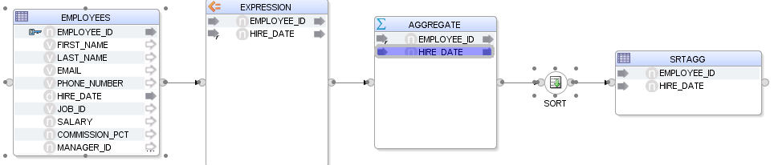
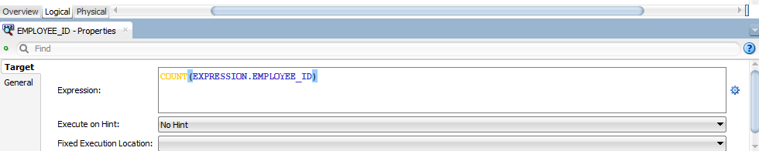
Aggregation Transformation:
Purpose: Aggregations are used to calculate summary statistics, such as sums, averages, counts, minimums, and maximums, on groups of data.
Usage: Aggregations are commonly applied when consolidating data or generating reports that require aggregated values.

Slide 13
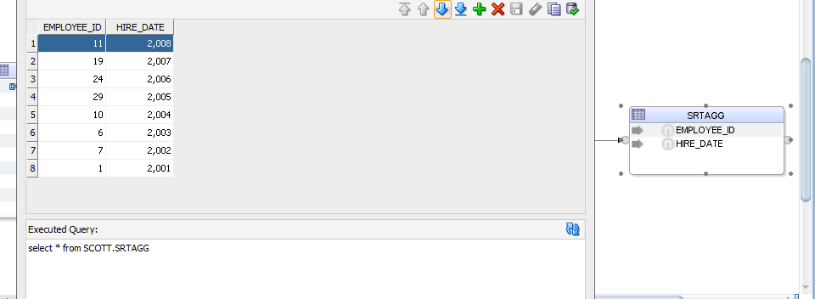
I have utilized an aggregate function, specifically 'count', to determine the total number of employees.

Slide 14
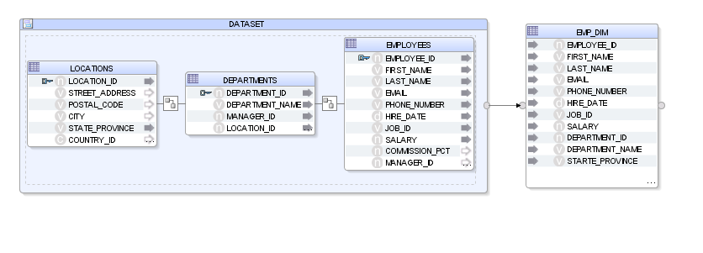
Data Set:
When configuring a transformation component (e.g., join, filter, lookup), you specify one or more input data sets from which the transformation will read data.
Input data sets can be tables from a database, flat files, or the output of previous transformation components in the data flow.
The transformation component processes the data within the input data sets according to the defined transformation logic.

Slide 15
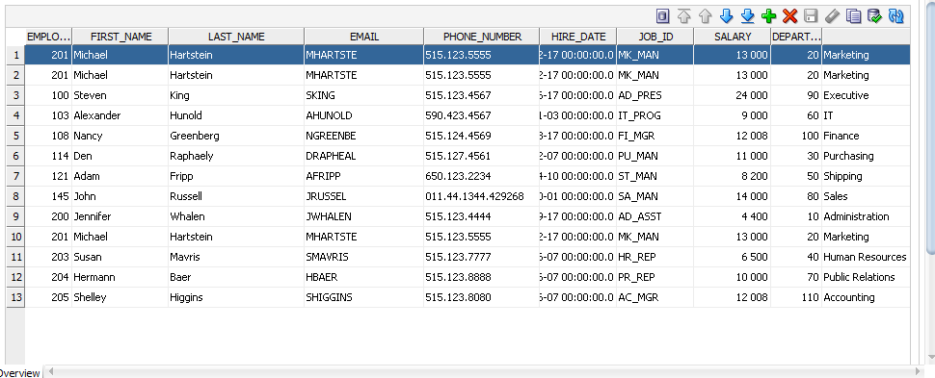
Data sets are joined using dataset transformation o create an employee dimension table.

Slide 16
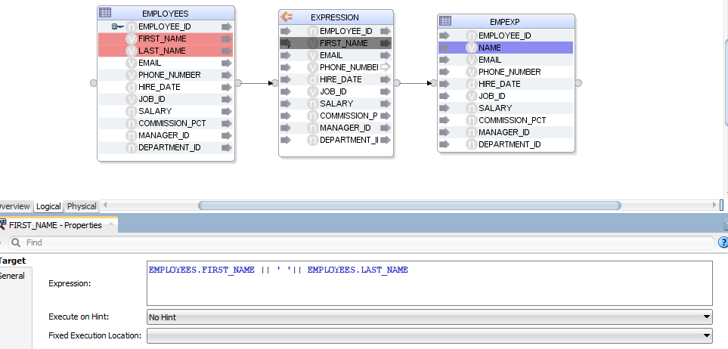
Expression Transformation:
Purpose: Expressions are used to perform calculations, manipulate values, and derive new data fields using mathematical operations, functions, and logical conditions.
Usage: Expressions are versatile and can be applied to transform data in various ways, such as concatenating strings, formatting dates, or performing conditional logic.

Slide 17
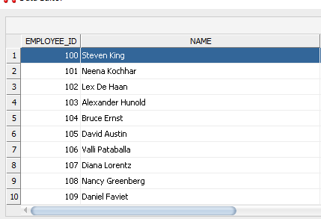

Slide 18
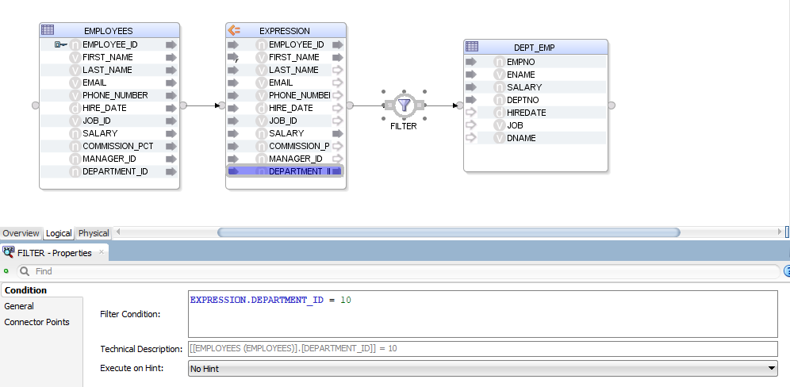
Filter Transformation:
Purpose: Filters are used to selectively include or exclude records from the data based on specified criteria.
Usage: Filters are employed to focus on specific subsets of data or to remove unwanted records before further processing.

Slide 19
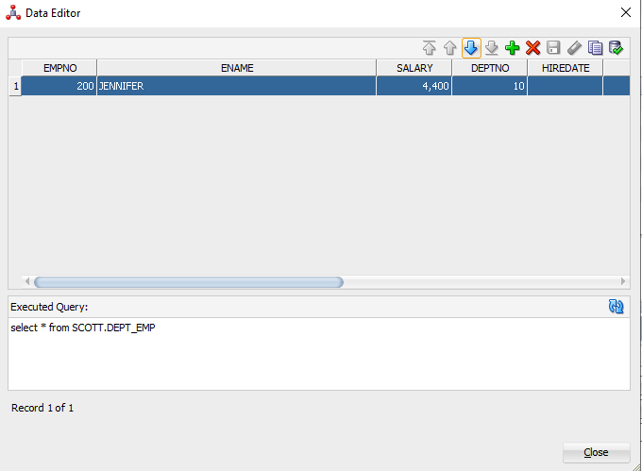
It selected department with 10.

Slide 20
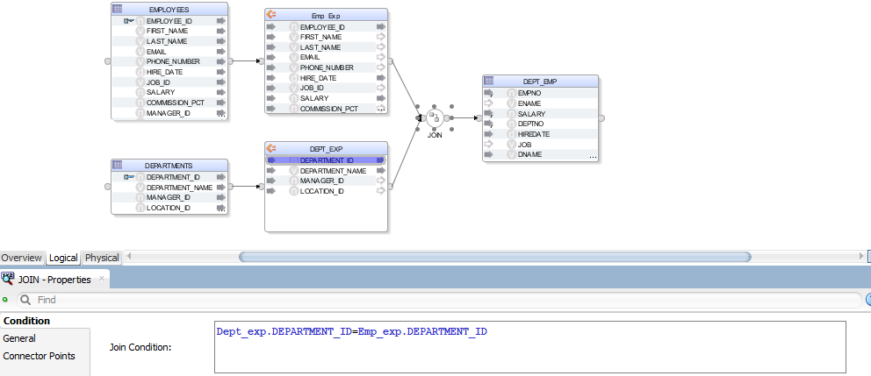
Join Transformation:
Purpose: Joins are used to combine data from multiple sources based on matching keys or conditions.
Usage: Joins are fundamental for integrating data from different tables, files, or databases that share common attributes.

Slide 21
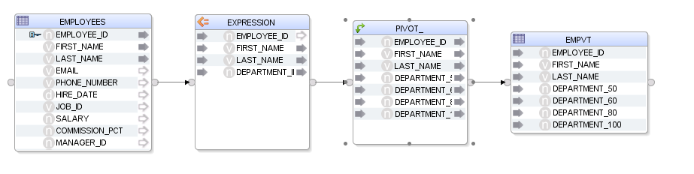
Pivot and Unpivot Transformation:
Purpose: Pivot and Unpivot transformations are used to rotate data from rows into columns (Pivot) or from columns into rows (Unpivot).
Usage: These transformations are handy for transforming data between wide and narrow formats or vice versa, facilitating analysis and reporting.

Slide 22
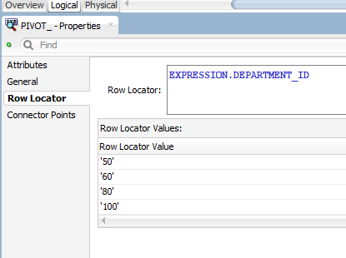
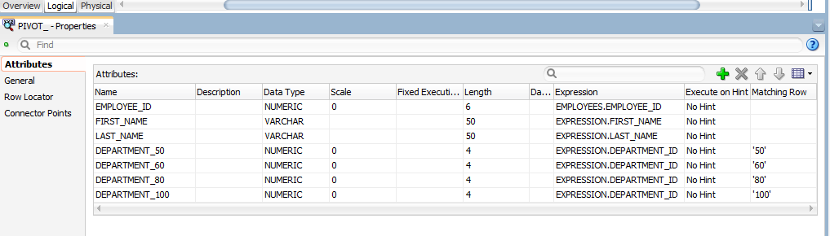
Create row locator variable for selecting in matching rows
Select the created row locators in matching rows below

Slide 23
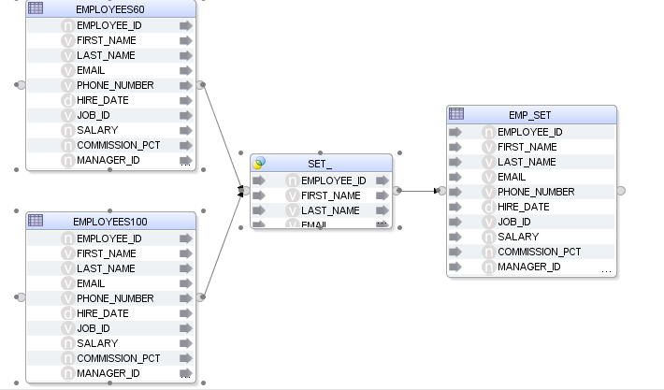
Set Operations:
Purpose: Set operations allow users to perform operations such as union, intersect, and minus between two or more datasets.
Usage: Set operations are useful for combining or comparing datasets to identify common records, differences, or to merge datasets without duplication.

Slide 24
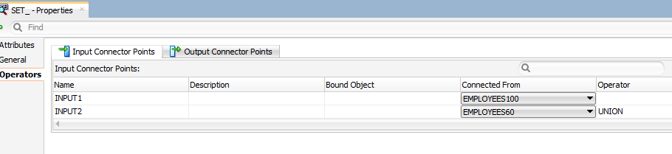
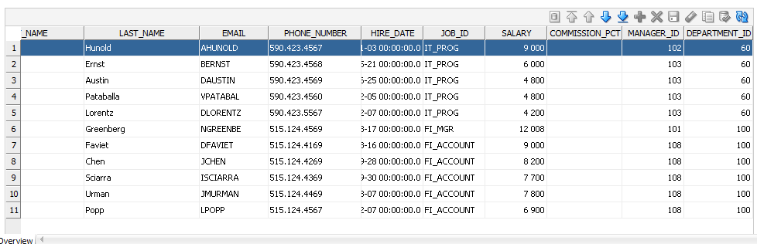

Slide 25
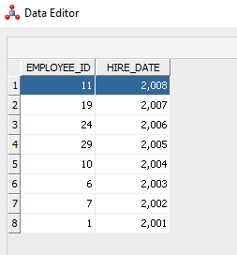
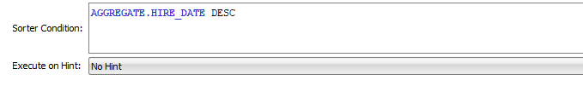
Sort Transformation:
Purpose: Sort transformations are used to order data based on specified criteria, such as ascending or descending order of values in one or more columns.
Usage: Sorting data is often necessary before performing certain operations, such as merging datasets or performing aggregate calculations.
The data is sorted by hire date descending

Slide 26
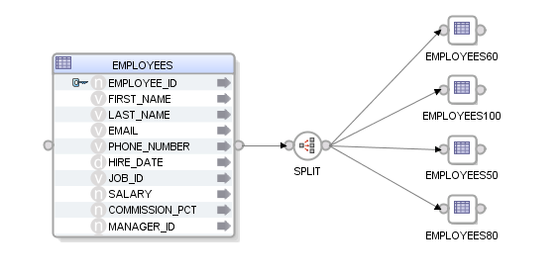
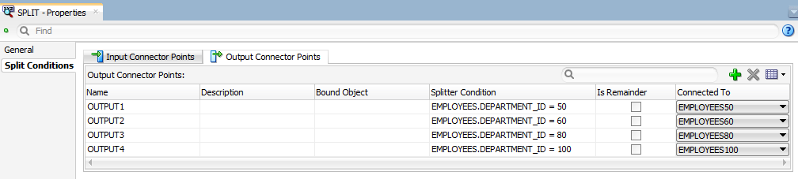
Split:
Purpose: The purpose of the Split transformation is to divide a dataset into smaller subsets or partitions based on specific conditions or criteria.
Usage: Split transformations are commonly used in scenarios where data needs to be partitioned for parallel processing, conditional routing, or distribution to different target systems or destinations.
The Department ids were divided into 50,60,80 and
100.

Slide 27
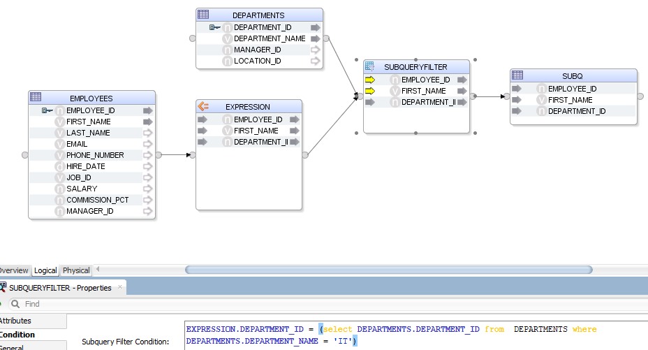
Subquery Filter:
Purpose: Subquery filters are used to filter data based on conditions that involve subqueries, allowing for more dynamic and complex filtering criteria.
Usage: Subquery filters are commonly used when the filtering criteria are based on values from another dataset, aggregate functions, or conditions that cannot be easily expressed using standard WHERE clause predicates.

Slide 28
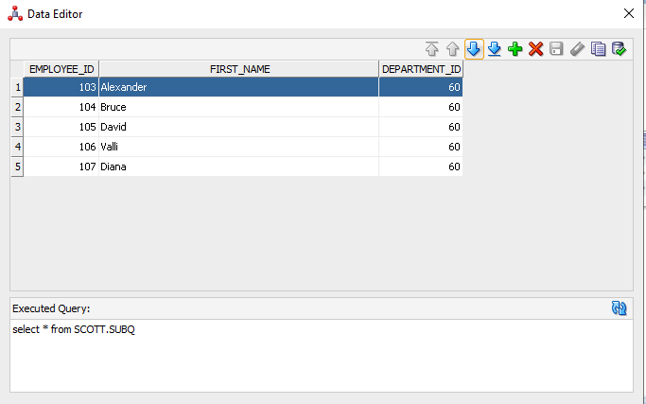
The department ids were filtered using subquery function

Slide 29
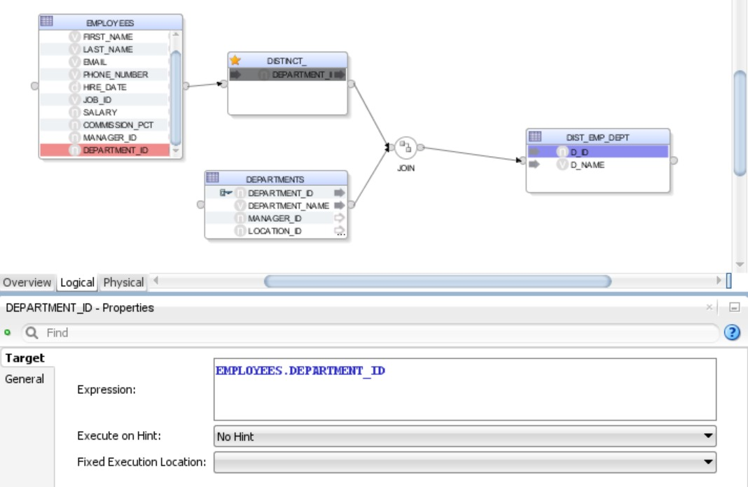
DISTINCT:
Purpose: The main purpose of using DISTINCT in ODI is to ensure that the result set of a query contains only unique rows.
Usage: In ODI, you can use the DISTINCT keyword in SELECT statements within interfaces, mappings, procedures, and other SQL-based components.
Here the distinct is used to select unique ids from department table

Slide 30
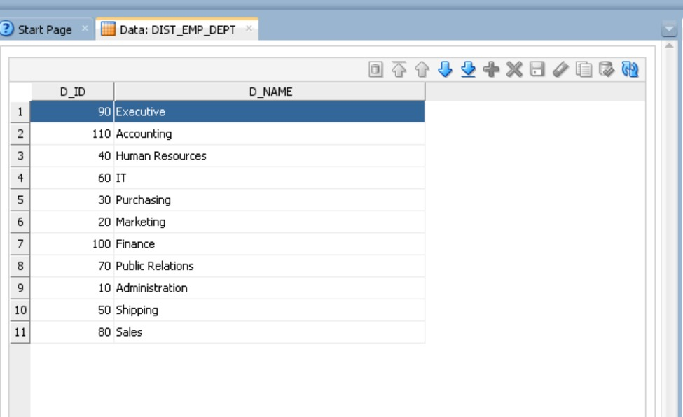
The output shows DISTINCT department ids and Department name

Slide 31
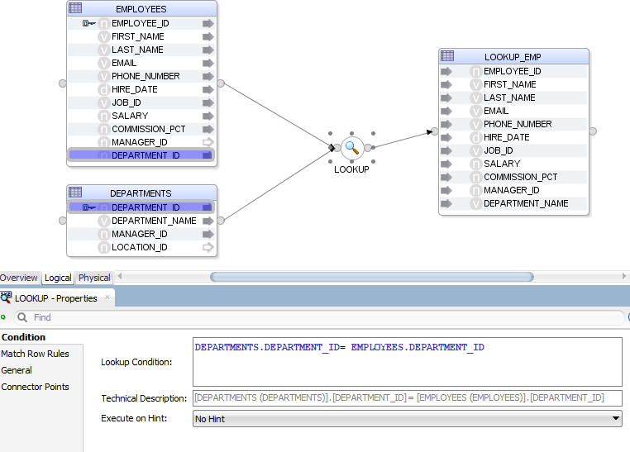
LOOKUP :
Purpose: The primary purpose of a lookup is to supplement or enhance existing data by fetching additional information from a reference source.
Usage: Lookups are typically performed within data integration processes, such as ETL (Extract, Transform, Load) workflows, mappings, or transformations.

Slide 32
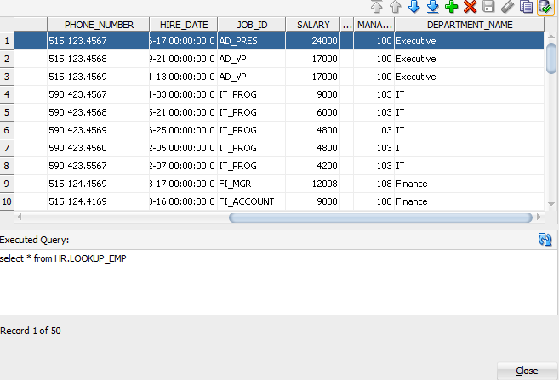
A JOIN operation is commonly used to combine data from the source table with the reference table based on a common key.
Data integration tools often offer lookup components or functions that facilitate the retrieval of data from reference sources, simplifying the implementation process.

Slide 33
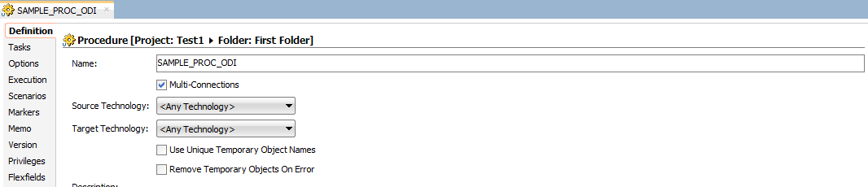
Procedure
Procedures in the context of databases are sets of SQL statements that are stored in the database and can be executed on demand. They allow you to group multiple SQL statements into a single unit and execute them together. Procedures can accept input parameters, perform operations, and return results. They are commonly used for tasks such as data manipulation, data validation, and business logic implementation within the database environment.
Right-click on Procedures:
In the Projects Navigator, expand the folder for your project, and then locate the "Procedures" node.
Right-click on the "Procedures" node to open the context menu.

Slide 34
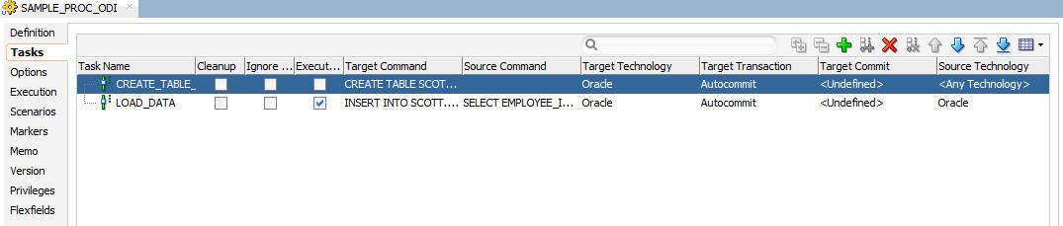
Select New Procedure:
From the context menu, select "New Procedure." This will open the "Create New Procedure" dialog box.
Enter Procedure Details:
In the "Create New Procedure" dialog box, you'll need to enter details about the new procedure:
Name: Provide a name for your procedure.
Folder: Select the folder where you want to save the procedure within your project.
Technology: Choose the appropriate technology for your procedure. This could be "SQL" for a SQL-based procedure, "Java" for a Java-based procedure, or "Generic" for a generic procedure that doesn't require specific technology.
Language: If applicable, select the programming language for your procedure (e.g., SQL or Java).

Slide 35
Design the Procedure:
Once you've provided the necessary details, click "OK" to create the procedure. This will open the procedure editor where you can design the logic for your procedure.
Depending on the technology and language chosen, you'll use the appropriate editor to define the procedure's code or logic.
Write Procedure Logic:
Write the code or logic for your procedure in the editor. For SQL procedures, you'll typically write SQL statements. For Java procedures, you'll write Java code.
Use the available features in the editor, such as syntax highlighting, code completion, and error checking, to help you write the procedure logic accurately.
Save the Procedure:
After you've finished designing the procedure, save your changes by clicking the "Save" button in the toolbar or by selecting "Save" from the File menu.

Slide 36
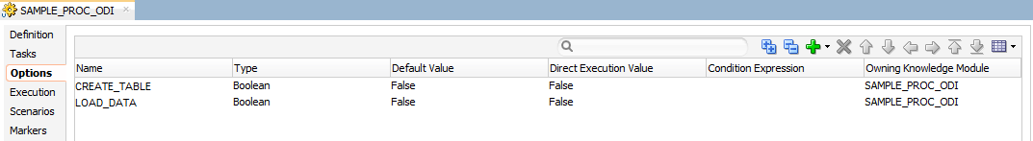
Validate the Procedure (Optional):
You can validate the procedure to check for any errors or issues. Right-click on the procedure in the Projects Navigator and select "Validate" from the context menu.

Slide 37
Reusable Mappings:
1)Modularity:
Reusable mappings promote modular design by allowing you to encapsulate specific data integration logic or transformations into separate mapping objects.
This modular approach enhances reusability and maintainability, as the same mapping logic can be easily reused across multiple data integration processes.
2)Consistency:
By centralizing common data transformation logic within reusable mappings, you ensure consistency in data processing across different integration projects or scenarios.
Any updates or enhancements made to a reusable mapping are automatically reflected wherever it is used, eliminating the need for redundant modifications.
3)Efficiency:
Reusable mappings help streamline development efforts by reducing duplication of effort and promoting a "build once, reuse many times" approach.
Developers can leverage pre-existing mapping components to accelerate the development of new data integration solutions, leading to increased efficiency and productivity.

Slide 38
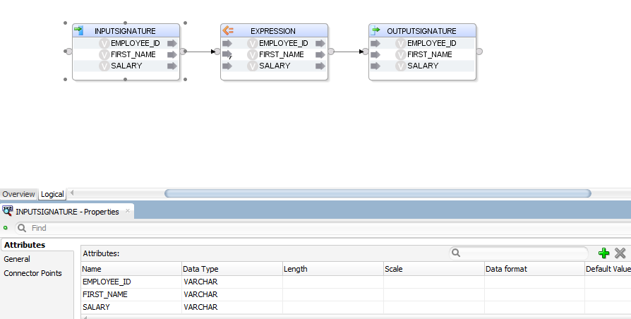
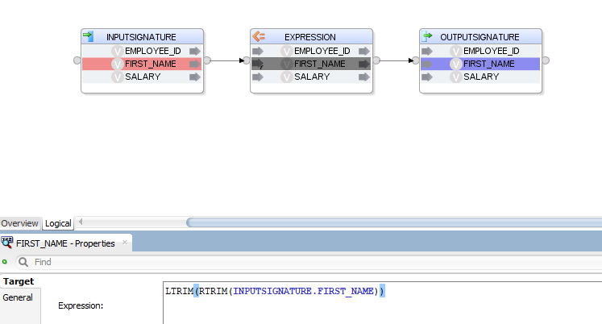
1.Click the plus mark to create attributes
2.Rename the attributes
1.Select the attributes and give the expressions

Slide 39
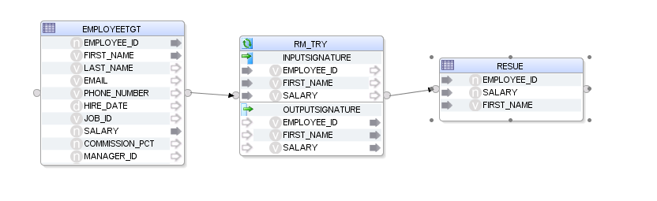
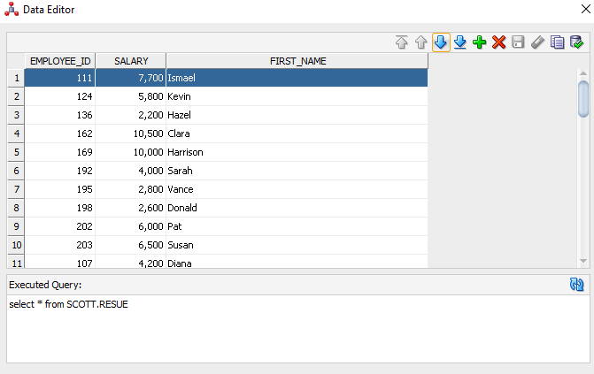
1.Create a new mapping and drag the source table
2.Drag the reusable mapping and map the columns
3.Drag the column able into the mapping section and map the reusable mapping and target mapping

Slide 40
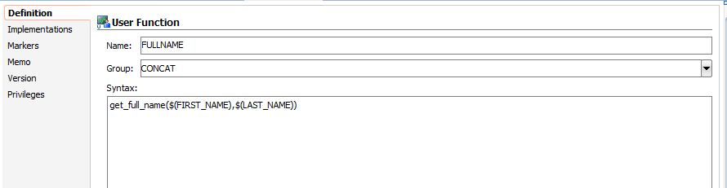
USER FUNCTIONS :
Purpose: User functions serve the purpose of encapsulating custom logic or operations that are not natively supported by ODI's built-in functions or transformations.
Usage: User functions are typically used within ODI mappings, interfaces, procedures, and other components where custom logic is required.
Create a new USER FUNCTION
Give a name and a give a group name (group is like folder)
Write the syntax with name and parameters

Slide 41
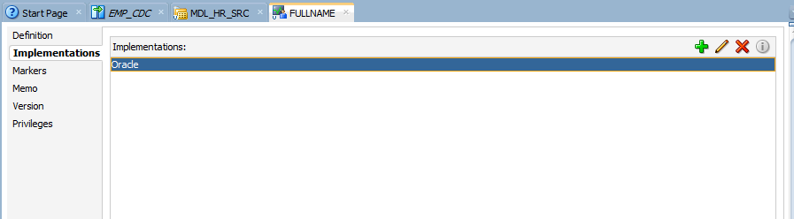
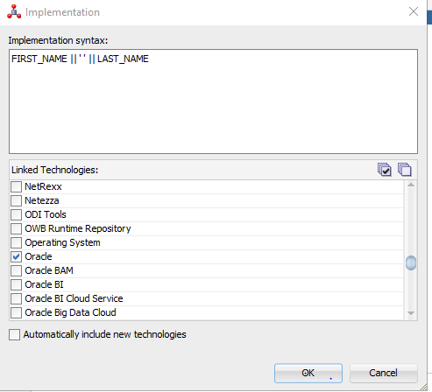
4) Go to implementation and click on the plus on the right top.
5) Write the implementation syntax and select the technology

Slide 42
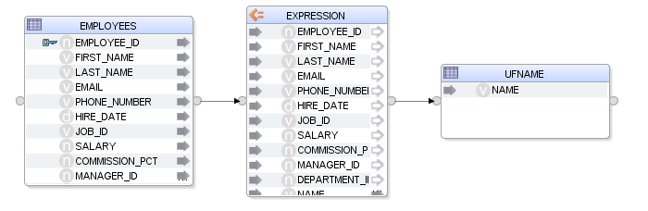
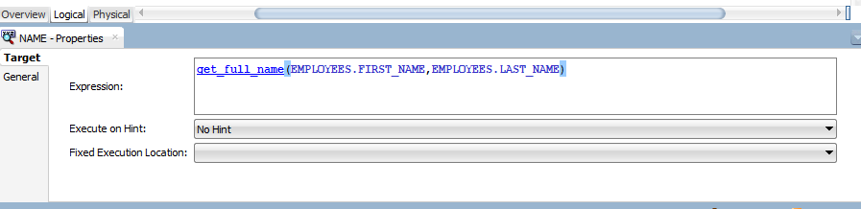
6) Create a new mapping and drag the source and target.
7) Select the column and in expression tab give the user function name and the column name
8) The target table will be transformed

Slide 43
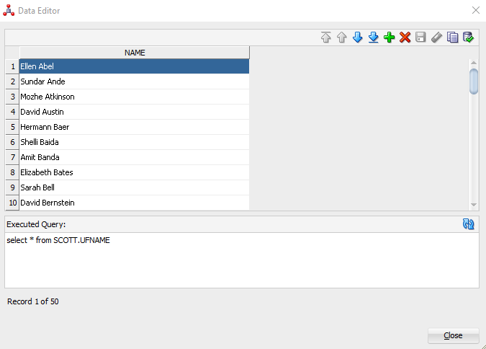

Slide 44
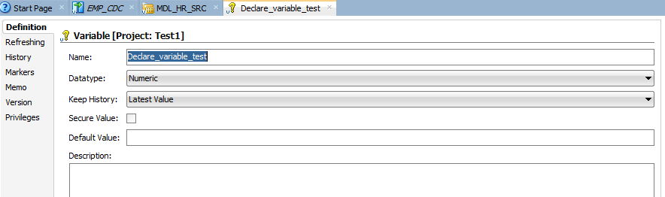
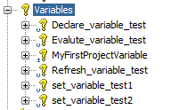
Variables:
User Variables: These are user-defined variables that you can create to store custom values. User variables are often used to parameterize ODI objects and provide flexibility in your integration processes.
Variables in ODI can be used in various contexts, including:
SQL queries
File paths and names
Model and datastore properties
Package and procedure steps
Knowledge Module options

Slide 45
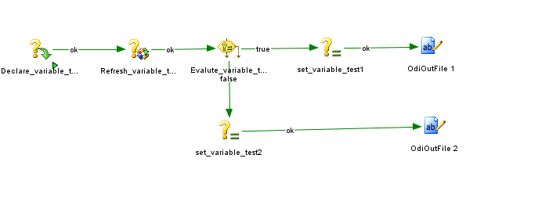
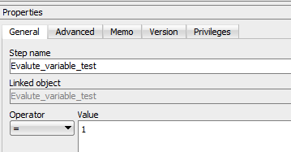
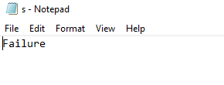
Map the variables which was created
Select the operator and give the value
The output will be displayed in the given location

Slide 46
Sequences:
In Oracle Data Integrator (ODI), a sequence is a mechanism used to generate unique numeric values automatically. Sequences are commonly used in scenarios where you need to generate unique identifiers for primary keys or other numeric values in your database tables.
Generating Primary Keys: Sequences are often used to generate primary key values for tables. Instead of relying on manual input or other mechanisms, you can use sequences to automatically generate unique identifiers for each new record inserted into a table.
Ensuring Uniqueness: Sequences guarantee uniqueness, ensuring that each generated value is unique across the table. This helps maintain data integrity and prevents conflicts or duplication of primary key values.
Optimizing Performance: Using sequences can improve performance compared to other methods of generating unique identifiers. Sequences are typically implemented at the database level and are optimized for generating numeric values efficiently.
Integration with ODI: In ODI, you can define sequences as part of your data models. ODI provides features to create and manage sequences directly within the interface, making it easy to incorporate them into your data integration workflows.
Usage in Mappings: Sequences can be utilized within ODI mappings to generate primary key values or other numeric identifiers during data transformation processes. You can include sequence calls within your mapping logic to fetch the next available value from the sequence and assign it to the appropriate columns in your target tables.
Data Quality and Consistency: By using sequences, you ensure that primary key values are generated consistently and follow a predefined sequence. This promotes data quality and consistency across your database tables.

Slide 47
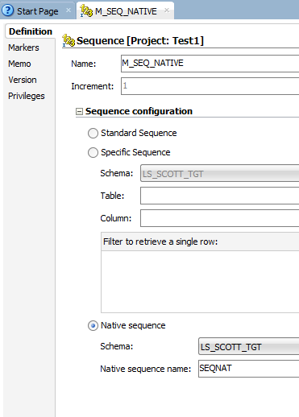
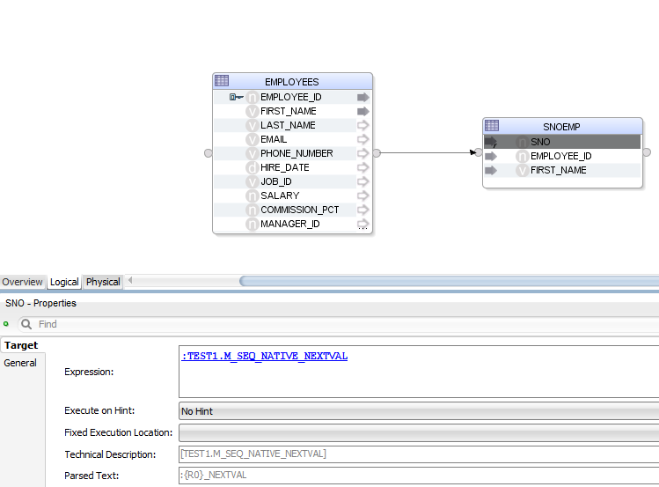
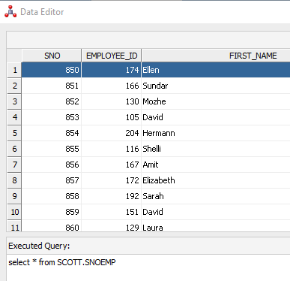
Create a sequence and type of sequence
Select the interval
Create a mapping and give the expression
Map the source and target
The output will be generated with keys

Slide 48
CDC:
CDC stands for Change Data Capture. It's a software design pattern and technique used in the field of data management and database systems. CDC captures changes made to data in a database and makes those changes available for further processing, such as replication to other databases, data warehousing, or real-time analytics.
Capture Changes: CDC captures changes that occur in a database, including inserts, updates, and deletes, typically at the row level.
Real-time or Batch: CDC can operate in real-time, capturing changes as they occur, or in batches, where changes are periodically polled and captured at intervals.
Minimal Impact: CDC typically minimizes the impact on the source database system by using database logs or other mechanisms to track changes without directly querying the database tables.
Data Integration: CDC is commonly used in data integration scenarios where changes in one database need to be propagated to other databases or systems, ensuring data consistency across the organization.
Data Replication: CDC is often used in data replication solutions where changes made to a source database are replicated to one or more target databases in near real-time.
Data Warehousing: CDC is useful for populating data warehouses or data lakes with up-to-date data, ensuring that the analytical systems have access to the latest information.
Event-Driven Architecture: CDC fits well with event-driven architectures, where systems react to changes in data by triggering actions or workflows.
Business Intelligence: CDC enables organizations to perform real-time or near real-time analytics on operational data, allowing for more timely decision-making.

Slide 49


1) Create a JKM and import JKM simple
2) Select Subscriber from the source table
3) Select the created JKM from subscriber
Add to CDC
Start Journal
The data will be captured from Source to target
Updated and inserted values will be reflected on target

Slide 50




